Slide 1


Johnathan Yong
11-06-2024

Slide 2

Outline
Executive Summary
Introduction
Methodology
Results
Conclusion
Appendix

Slide 3
Executive Summary
Methodologies
Data Collection through API
Data Collection through Web Scrapping
Data Wrangling
Exploratory Data Analysis with SQLite
Exploratory Data Visualization
Interactive Data Visualization with Folium
Interactive Data Dashboarding with Plotly Dash
Machine Learning Predictions
Summary of Results
Exploratory Data Analysis
Interactive Plotly Dashboard
Machine Learning Predictions

Slide 4
Introduction
Project Background & Context
SpaceX advertises Falcon 9 rocket launches on its website with a cost of $ 62 million; other providers cost upward of $ 165 million dollar, much of the savings is from SpaceX first stage reuse. Therefore, if we can determine if the first stage will land, we can determine the cost of a launch. This information can be used if an alternate company wants to bid against SpaceX for a rocket launch. This goal of the project is to create a machine learning pipeline to predict if the first stage will land successfully.
Problems you want to find answers
What factors determine if the rocket will land successfully?
What are the interactions amongst various features that will determine the rate of a successful landing?
What operating conditions needs to be in place so to ensure a successful landing program?

Slide 5

Section 1

Slide 6
df['Outcome']
Methodology
Executive Summary
Data collection methodology:
Data was collected through SpaceX API and web scrapping on Wikipedia.
Perform data wrangling
With One Hot Encoding, categorical features in the dataset were represented as numerical variables for use in machine learning predictions.
Perform exploratory data analysis (EDA) using visualization and SQL
Perform interactive visual analytics using Folium and Plotly Dash
Perform predictive analysis using classification models
Logistic Regression, Support Vector Machine, K-Nearest Neighbor and Decision Tree were chosen as data prediction algorithms.

Slide 7
Data Collection
The data sets were collected through the SpaceX API and Wikipedia web-scrapping.
SpaceX API:
A GET Request was made to the SpaceX API
The response was decoded into a Json object with the .json function and into a Pandas data frame with the .json_normalize() function.
The data was then filtered for relevant entries, checked and filled for missing values for where was necessary.
Wikipedia:
A HTTP GET Request was made to a static URL on Wikipedia.
A BeautifulSoup object was created from the HTML response to access the relevant table, to parse the contents from the launch HTML table, then to be converted into a Pandas data frame for future analysis.

Slide 8
Data Collection – SpaceX API
Making a GET Request
The URL of the SpaceX is determined.
The requests.get() method is applied on the URL to get a response.
Decoding and conversion
The response was checked for success and decoded into a Json object with the .json() method.
It is then converted into a Pandas data frame with the .json_normalize() method.
Data Manipulation
The data frame is pre-processed for keeping only features that are relevant.
A new data frame with global variables is created to store the relevant features.
The dataset is then further filtered, checked and filled for missing values for further action.
A GET request was made to the SpaceX API for data collection, which was then preprocessed for basic data wrangling, formatting and filling in null values.
Link to the GitHub Notebook:
https://github.com/JohnLeGreat/data_science_capstone_project/blob/main/01%20SpaceX%20Data%20Collection%20API.ipynb

Slide 9
Data Collection - Scraping
Creating a BeautifulSoup object
The requests.get() method is applied on the Wikipedia page URL for a response.
A BeautifulSoup object is created from the HTML response.
Parsing of contents
Column names from the HTML table header are extracted.
An empty dictionary is created with the column names and is filled with relevant entries from the HTML table.
Conversion into a Pandas dataframe
The filled dictionary is converted into a Pandas dataframe with the pd.DataFrame() method.
A BeautifulSoup object was created for collection of historical launch records of the Falcon 9 from Wikipedia, of which then is parsed and converted into a Pandas data frame.
Link to the GitHub Notebook:
https://github.com/JohnLeGreat/data_science_capstone_project/blob/main/02%20SpaceX%20Web%20Scraping.ipynb

Slide 10
Data Wrangling
The percentage of missing values in each attribute is determined, and identified whether they are categorical/numerical attributes.
After which, initial calculations were performed, as follows:
Number of launches in each site.
Number and occurrence of launches in each orbit.
Number and occurrence of mission outcomes in said orbit.
From the Outcome column, a numerical Class column is created for use in further stages of machine learning predictions.
Link to the GitHub notebook:
https://github.com/JohnLeGreat/data_science_capstone_project/blob/main/03%20SpaceX%20Data%20Wrangling.ipynb

Slide 11
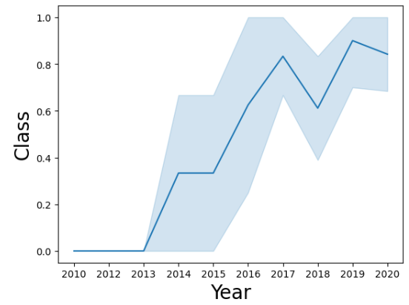
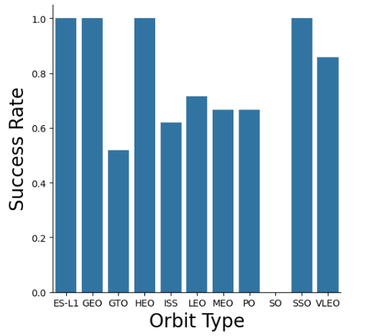
EDA with Data Visualization
The success rate in each orbit type is visualized through a bar plot.
The launch success rate by year is visualized through a line plot.
Other types of visualizations include scatter plots (no. of flights/corresponding orbit, payload mass/orbit) etc.
Link to the GitHub notebook:
https://github.com/JohnLeGreat/data_science_capstone_project/blob/main/05%20SpaceX%20Exploratory%20Data%20Analysis%20with%20Visualization.ipynb

Slide 12

EDA with SQL
Using IBM Db2, Exploratory Data Analysis with SQLite is performed to get insights on the dataset. Examples of queries were performed were as follows:
Names of unique launch sites in space missions.
Total payload mass carried by boosters launched by NASA (CRS).
Average payload mass carried by booster version F9 v1.1
Total number of successful and failure mission outcomes.
Link to the GitHub notebook:
https://github.com/JohnLeGreat/data_science_capstone_project/blob/main/
04%20SpaceX%20Exploratory%20Data%20Analysis%20with%20SQLLite.ipynb

Slide 13
Building an Interactive Map with Folium
All the launch sites were marked, and map objects, such as markers and circles were added to demonstrate the outcomes of launches for each site on the Folium map.
The outcomes were assigned to separate classes of 0 and 1 respectively for failure and success.
With color-labeled marker clusters, the launch sites with a relatively high success rate were identified.
Calculations of the distances between a launch site to its proximate features were done, which included railways, highways, coastlines and cities.
Link to the GitHub notebook:
https://github.com/JohnLeGreat/data_science_capstone_project/blob/main/06%20SpaceX%20Interactive%20Visualization%20with%20Folium.ipynb

Slide 14
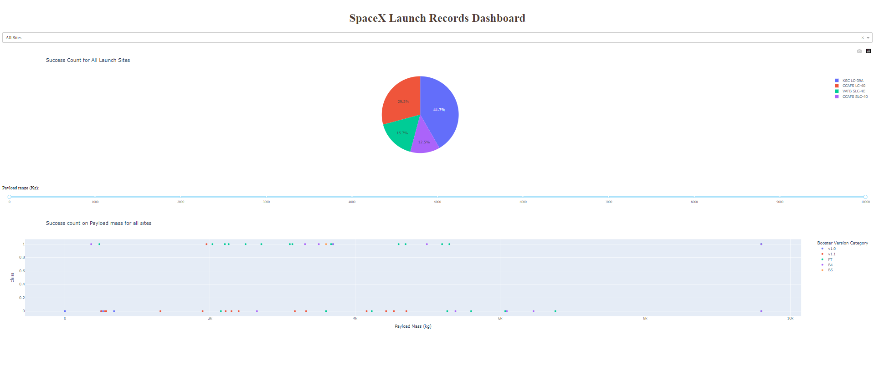
Building a Dashboard with Plotly Dash
An interactive dashboard was made through Plotly Dash.
A pie chart is displayed to visualize the proportion of successful launches by site for all launch sites, and the proportion of successful/failed launches for each launch site.
A scatter plot is displayed to visualize the relationship between payload mass and its corresponding launch outcome for each booster version category, which can be viewed for all launch sites or by each launch site.
Link to the GitHub notebook:
https://github.com/JohnLeGreat/data_science_capstone_project/blob/main/07%20SpaceX%20Interactive%20Dashboard%20with%20Plotly.txt

Slide 15
Predictive Analysis (Classification)
The initial dataset is split into a training and testing set.
Logistic Regression, Support Vector Machine, K-Nearest Neighbor and Decision Tree models were to be selected as the prime data prediction algorithm for categorical outcomes.
The models were imported, a GridSearchCV object was created, and their parameters were tuned, respectively.
The models were trained, and their accuracy scores were calculated and confusion matrices plotted.
The best performing classifying model is found to be the Decision Tree model.
Link to the GitHub notebook:
https://github.com/JohnLeGreat/data_science_capstone_project/blob/main/08%20SpaceX%20Machine%20Learning%20Prediction.ipynb

Slide 16
Results
EDA
The orbits that has full success rates are ES-L1, GEO, HEO, and SSO.
For LEO, number of flights have positive correlation with success rate; however, in GTO, the number of flights seem to have no correlation with success rate.
For Polar, LEO and ISS, payload mass is positively correlated with success rate; however, in GTO, the correlation is indistinguishable.
The success rate of launches is increasing by year since 2013.

Slide 17

Results
Plotly Dashboard

Slide 18
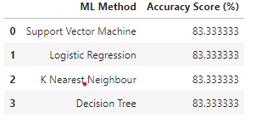
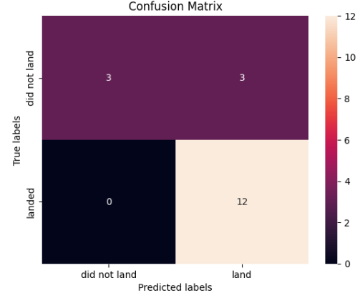
Results
Predictive analysis results
All machine learning models have similar accuracy scores.
The machine learning models produced similar confusion matrices.

Slide 19

Section 2

Slide 20
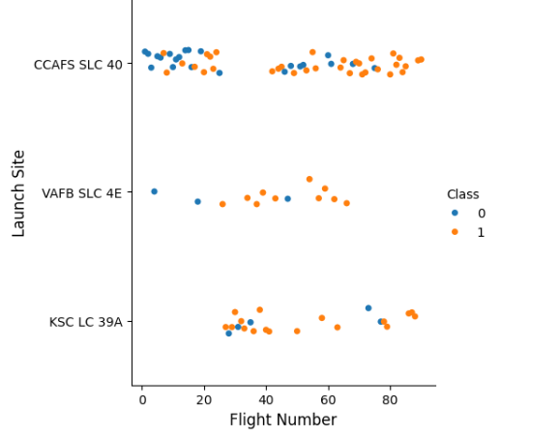
Flight Number vs. Launch Site
From the scatter plot, flight number is positively correlated with launch success, where flight number > 20 charted more positive outcomes.

Slide 21
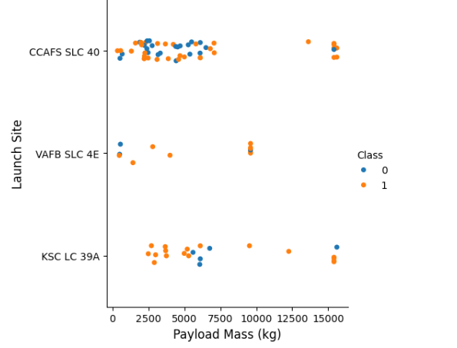
Payload vs. Launch Site
From the scatter plot, payload mass is positively correlated with launch success.

Slide 22
Success Rate vs. Orbit Type
From the bar chart, launches to orbits ES-L1, GEO, HEO and SSO has the highest success rates, whereas launches to orbits GTO has the lowest success rate.

Slide 23
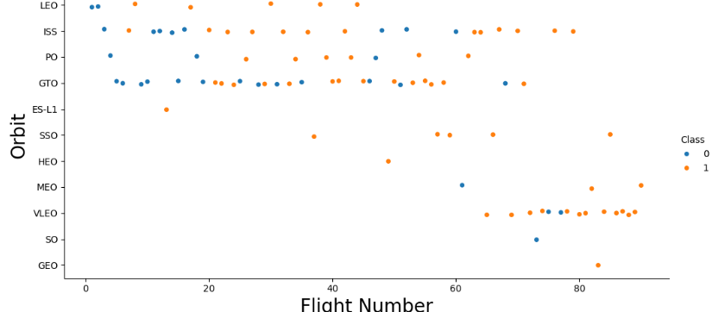
Flight Number vs. Orbit Type
From the scatter plot, flight number is positively correlated with launch success, except in GTO, where the relationship is indistinguishable.

Slide 24
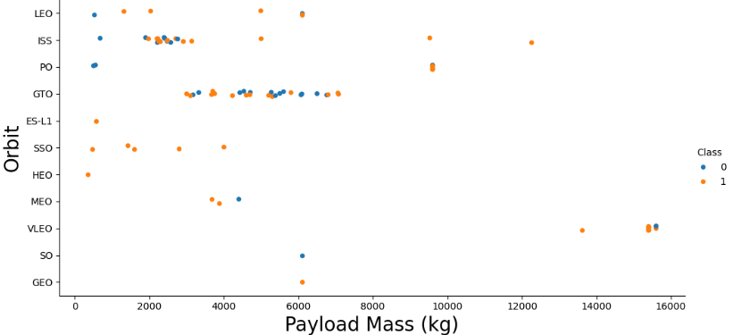
Payload vs. Orbit Type
From the scatter plot, payload mass is positively correlated with launch success in LEO, ISS and PO.
However, in GTO, the relationship is not distinguishable; there seems to be no relationship between payload mass and launch success.

Slide 25

Launch Success Yearly Trend
From the line plot, the success rate of launches has been increasing substantially since the year 2013.

Slide 26
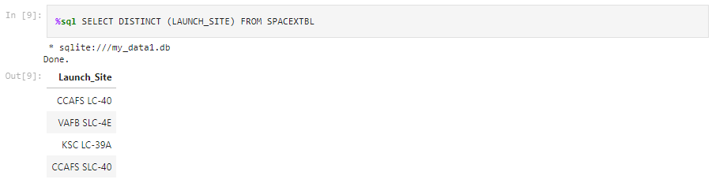
All Launch Site Names
The unique launch site names are CCAFS LC-40, VAFB SLC-4E, KSC LC-39 A and CCAFS SLC-40.

Slide 27
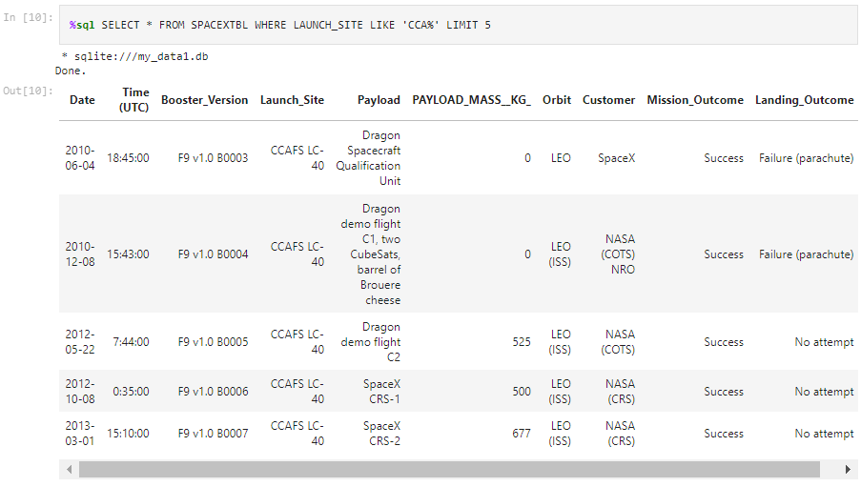
Launch Site Names Begin with 'CCA'
The 5 record with launch site names beginning with ‘CCA’ were as follows:

Slide 28
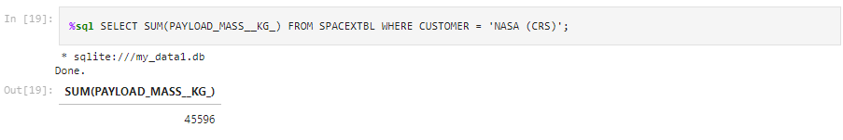
Total Payload Mass
The total payload mass carried by boosters from NASA(CRS) were 45596 kg.

Slide 29
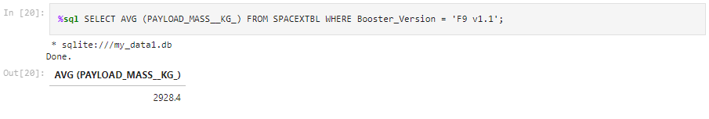
Average Payload Mass by F9 v1.1
The average payload mass carried by booster version F9 v1.1 is 2928.4 kg.

Slide 30
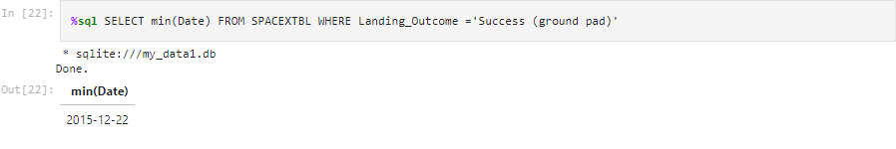
First Successful Ground Landing Date
The date of the first successful landing outcome on ground pad is on 22nd of December, 2015.

Slide 31
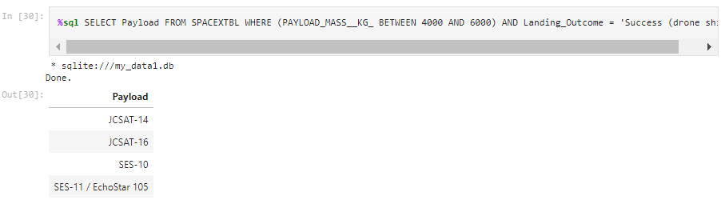
Successful Drone Ship Landing with Payload between 4000 and 6000
The names of boosters which have successfully landed on drone ship and had payload mass > 4000 but < 6000 kg are JCSAT-14, JCSAT-16, SES-10 and SES-11.

Slide 32
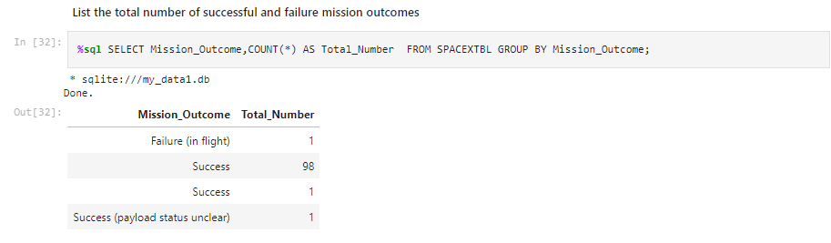
Total Number of Successful and Failure Mission Outcomes
The total number of successful outcomes is 100 whereas for failed outcomes is 1.

Slide 33
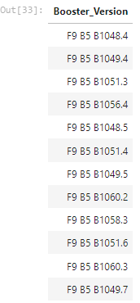
Boosters Carried Maximum Payload
The names of the booster which have carried the maximum payload mass is listed on the right.
The query that was used is:
%sql SELECT Booster_Version FROM SPACEXTBL WHERE PAYLOAD_MASS__KG_ = (SELECT MAX(PAYLOAD_MASS__KG_) FROM SPACEXTBL)

Slide 34
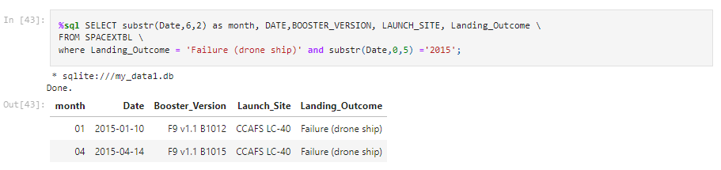
2015 Launch Records
The 2 failed landing outcomes in drone ship, along with their booster version, and launch site names in the year 2015 is listed below.

Slide 35
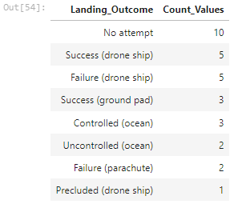
Rank Landing Outcomes Between 2010-06-04 and 2017-03-20
The count of landing outcomes between 2010-06-04 and 2017-03-20 is ranked in the descending order, as shown in the right.
The query that was used is:
%sql SELECT Landing_Outcome, Count(*) AS Count_Values FROM SPACEXTBL WHERE DATE BETWEEN '2010-06-04' AND '2017-03-20' GROUP BY Landing_Outcome ORDER BY Count_Values DESC;

Slide 36

Section 3

Slide 37
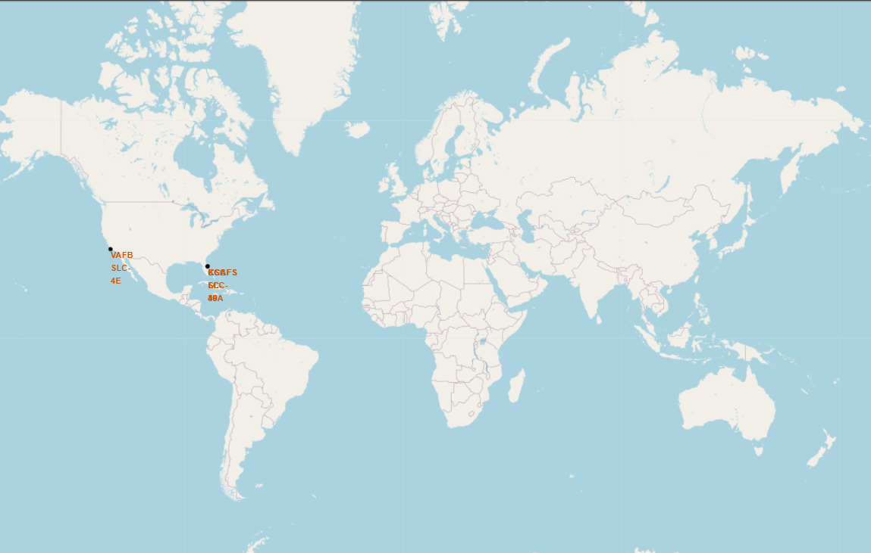
Launch Sites Global Map Markers
The launch sites for SpaceX are located in the United States of America, one each on the West and East coast.

Slide 38
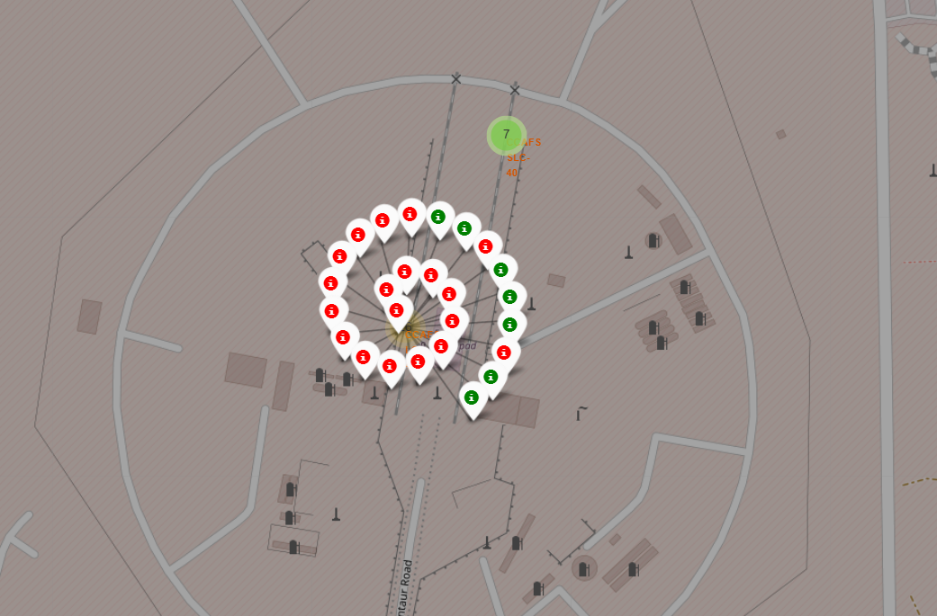
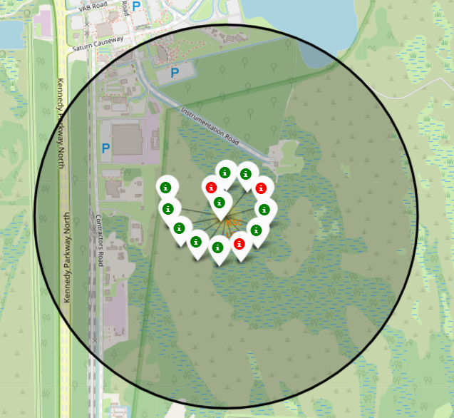
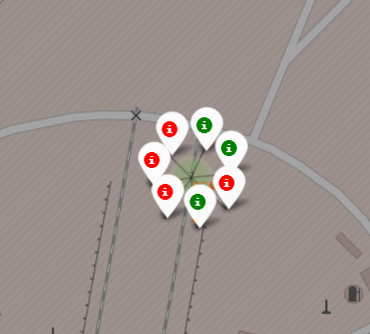
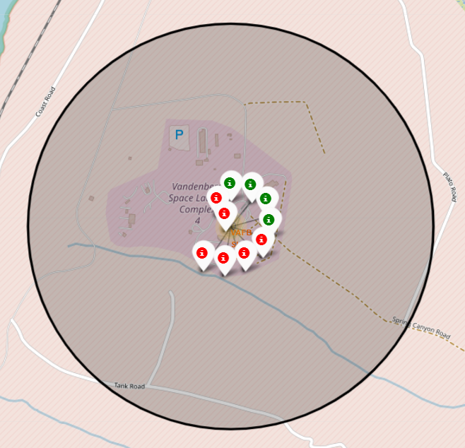
Launch Sites with Color labels
Top left, right and bottom left is from the East coast whereas bottom right is from the West coast
Green = success,
Red = failure.

Slide 39

Distance of Launch Sites to Proximate features

Slide 40

Section 4

Slide 41
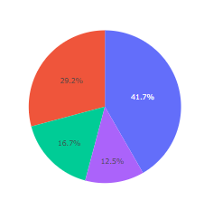
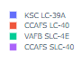
Pie chart visualizing success of launches by sites
KSC LC 39-A seemed to have the highest proportion of successful launches in all the sites.

Slide 42
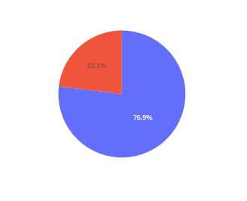
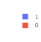
Pie chart showing launch success to failure ratio of KSC LC 39-A
KSC LC 39-A achieved a 76.9 % success launch rate, the highest of the 4 sites.

Slide 43
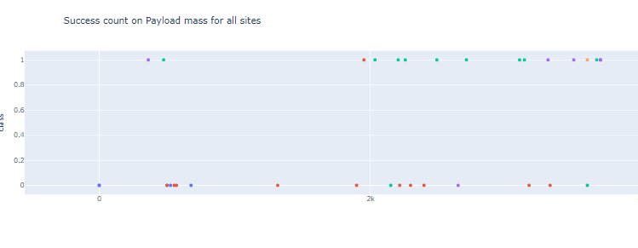
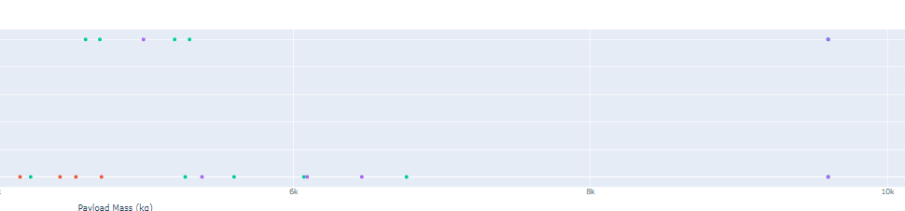
Scatter plot between payload mass and success rate
Payload mass seems to have a negative correlation with launch success; Low-weighted payloads seem to have a higher success rate than the high-weighted payloads.

Slide 44

Section 5

Slide 45

Classification Accuracy
The Decision Tree classifier is the model with the highest classification accuracy.

Slide 46
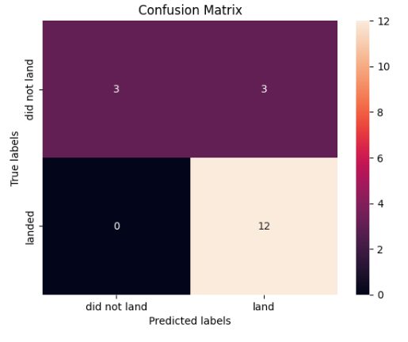
Confusion Matrix of Decision Tree classifier
Examining the confusion matrix, we see that Decision Tree can distinguish between the different classes. The major problem here is the false positives: where the classifier classifies unsuccessful landings as successful.

Slide 47
Conclusions
From the presentation, we can conclude that:
Flight number is positively correlated with launch success.
Launch success rate increased substantially since the year 2013.
The orbits ES-L1, GEO, HEO, SSO has the highest success rates, whereas GTO has the least success rates, with unpredictable outcomes.
KSC LC-39A had the most successful launches out of the 4 sites.
The Decision tree classifier is the best machine learning algorithm for the task of predictive analyses.

Slide 48


